Slide 1
How can you believe, who receive honour from one another, and do not seek the honour that comes from the only God?
John 5:44 (NKJV)
So how can we believe?

Slide 2
Let’s pray…

Slide 3
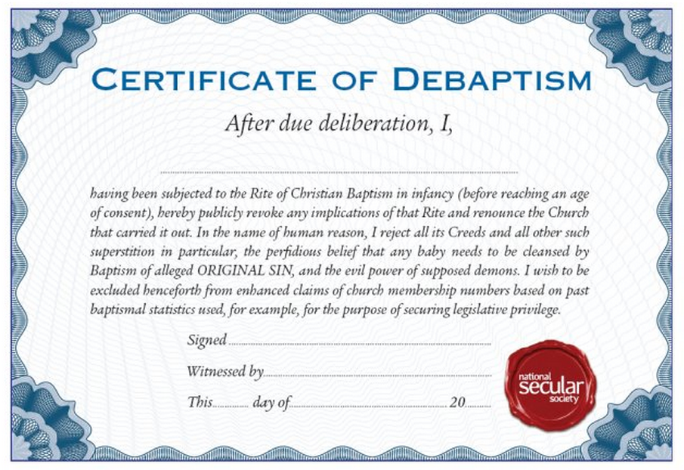
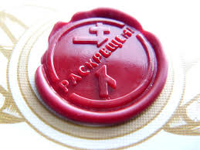

Slide 4
I. Our Lord Jesus Christ was inclusive.
John 3:16 says;
“For God loved the world so much that he gave his only Son, so that everyone who believes in him may not die but have eternal life.”
So how can they believe?

Slide 5
John chapter 4 The Samaritan woman
She believed
John chapter 4:39-42 many Samaritans
They believed
John chapter 4:43-54 a Royal official
He and his household believed

Slide 6
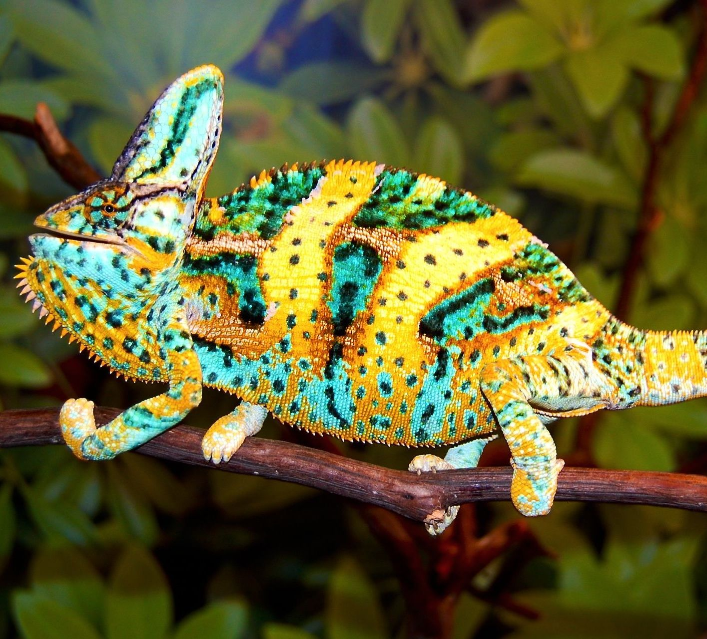
II. They were seeking people’s approval.
Chameleon syndrome
It is a term to describe someone who changes who they are depending on who they’re around.
This would be a characteristic of someone who is always looking for approval.

Slide 7
Jesus said; How can you believe, who receive honour from one another, and do not seek the honour that comes from the only God?
“You study the Scriptures diligently because you think that in them you have eternal life. These are the very Scriptures that testify about me,”
John 5:39 (NIV)
They thought it was enough just to read
and study the Bible.

Slide 8
John 5:47 says;
⁴⁷ But since you do not believe what he wrote, how are you going to believe what I say?”
This can happen in our time.
The question for us is:
Are we truly searching the Scriptures, are we seeking with all our heart and soul for the honour that comes from the only God?

Slide 9
But Jesus says to them
“yet you refuse to come to me to have life”.
So how can they believe?
He said to them, “You are the ones who justify yourselves in the eyes of others, but God knows your hearts. What people value highly is detestable in God’s sight.
Luke 16:15 (NIV)

Slide 10
III. What do we have to do?
Jesus’ answer is “seek the honour that comes from the only God.”
For the wages of sin is death, but the gift of God is eternal life in Christ Jesus our Lord.
Romans 6:23 (NIV)

Slide 11
III. What do we have to do?
Jesus’ words are in John 5:23
“that all may honour the Son just as they honor the Father. Whoever does not honour the Son does not honour the Father, who sent him.”
We need to be God-pleasers.

Slide 12
We should try to please people but not at the expense of displeasing God.
How can you believe, who receive honour from one another, and do not seek the honour that comes from the only God?
John 5:44 (NKJV)
We need to be God-pleasers.

