Slide 1
“²⁶ A week later his disciples were in the house again, and Thomas was with them. Though the doors were locked, Jesus came and stood among them and said, “Peace be with you!” ²⁷ Then he said to Thomas, “Put your finger here; see my hands. Reach out your hand and put it into my side. Stop doubting and believe.”
²⁸ Thomas said to him, “My Lord and my God!”
John 20:26 – 28 (NIV).

Slide 2
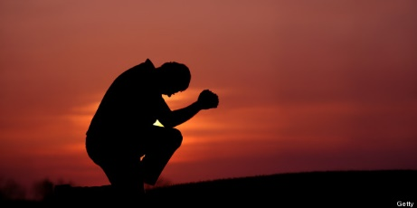
Let’s pray…

Slide 3
The Sunday after Easter
I. Easter Sunday night.
a) The risen Lord.
¹⁹ On the evening of that first day of the week, when the disciples were together, with the doors locked for fear of the Jewish leaders, Jesus came and stood among them and said, “Peace be with you!” ²⁰ After he said this, he showed them his hands and side. The disciples were overjoyed when they saw the Lord.
John 20:19 – 20 (NIV).

Slide 4
a) The risen Lord.
²¹ Again Jesus said, “Peace be with you! As the Father has sent me, I am sending you.” ²² And with that he breathed on them and said, “Receive the Holy Spirit. ²³ If you forgive anyone’s sins, their sins are forgiven; if you do not forgive them, they are not forgiven.”
John 20:21 – 23 (NIV).
Glory! Hallelujah! It is the Lord.

Slide 5
b) The absent Thomas.
“But Thomas, one of the twelve, called Didymus, was not with them when Jesus came”
John 20:24 (NIV).
Then Thomas (also known as Didymus) said to the rest of the disciples, “Let us also go, that we may die with him.”
John 11:16 (NIV)

Slide 6
c) The witnessing disciples.
“So the other disciples told him, “We have seen the Lord!” But he said to them, “Unless I see the nail marks in his hands and put my finger where the nails were, and put my hand into his side, I will not believe.”
John 20:25 (NIV).
Thomas said,
“You’ve had a great emotional experience.”

Slide 7
II. The Sunday after Easter.
a) The risen Lord Jesus appeared again
²⁶ A week later his disciples were in the house again, and Thomas was with them. Though the doors were locked, Jesus came and stood among them and said, “Peace be with you!” ²⁷ Then he said to Thomas, “Put your finger here; see my hands. Reach out your hand and put it into my side. Stop doubting and believe.”
²⁸ Thomas said to him, “My Lord and my God!”
²⁹ Then Jesus told him, “Because you have seen me, you have believed; blessed are those who have not seen and yet have believed.”
John 20:26-29 (NIV).

Slide 8
II. The Sunday after Easter.
b) Thomas’ confession of faith
“Thomas said to him, “My Lord and my God!”
John 20:28 (NIV).
“His statement is not only the culmination of belief; it is also the climax of the Gospel.
Charles Erdman, The Gospel of John, The Westminster Press, Philadelphia, 1944, p.170

Slide 9
“My Lord and my God!”
“Awake, and rise to my defense! Contend for me, my God and Lord”
Psalm 35:23 (NIV)
King David says; “My God and my Lord.”, terms only applicable to Jehovah.

Slide 10
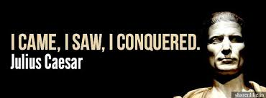
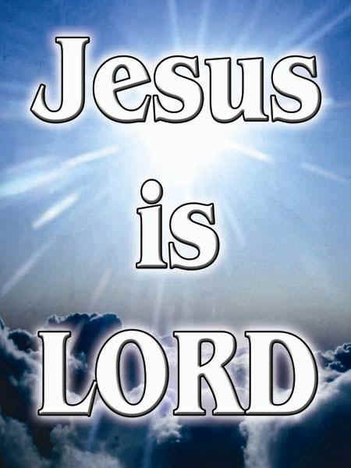
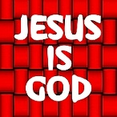
‘Caesar is Lord, Caesar is God!’
“Our Lord and our God!”

Slide 11
III. Thomas’ virtues and mistake
a) Thomas’ mistake: “He withdrew from the Christian fellowship”
Hebrews 10:24-25 says;
²⁴ And let us consider how we may spur one another on toward love and good deeds, ²⁵ not giving up meeting together, as some are in the habit of doing, but encouraging one another—and all the more as you see the Day approaching.

Slide 12
b) Thomas’ virtues: First, "He was honest”
“There is more ultimate faith in the man who insists on being sure than in the man who glibly repeat things which he has never thought out, and which he may not really believe. It is doubt like that which in the end arrives at certainty”
William Barclay

Slide 13
b) Thomas’ virtues: Second, "He persevered”
Thomas arrived at an absolute certainty for he said; “My Lord and my God!”…he doesn’t said “Lord and God” no, he said; “My Lord and my God”.
Then Jesus told him, “Because you have seen me, you have believed; blessed are those who have not seen and yet have believed.”
John 20:29 (NIV)
It is what we do not see that is the strength of our hearts.

Slide 14
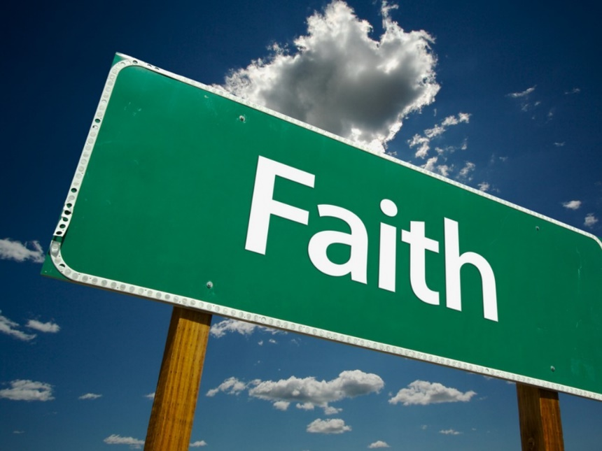
“So we fix our eyes not on what is seen, but on what is unseen, since what is seen is temporary, but what is unseen is eternal”.
2 Corinthians 4:18 (NIV)
It is what we do not see that is the strength of our hearts.

Slide 15
“Though you have not seen him, you love him; and even though you do not see him now, you believe in him and are filled with an inexpressible and glorious joy ⁹ for you are receiving the end result of your faith, the salvation of your souls.”
1 Peter 1:8-9 (NIV)

Slide 16
³⁰ Jesus performed many other signs in the presence of his disciples, which are not recorded in this book. ³¹ But these are written that you may believe that Jesus is the Messiah, the Son of God, and that by believing you may have life in his name.
John 20:30-31 (NIV)
John invites us to believe, to have faith in Him; by committing ourselves personally to Jesus as our Christ and our Lord.

