Slide 1
⁶ For this reason I remind you to fan into flame the gift of God, which is in you through the laying on of my hands. ⁷ For the Spirit God gave us does not make us timid, but gives us power, love and self-discipline.
2 Timothy 1:6-7 (NIV)
⁶ Wherefore I put thee in remembrance that thou stir up the gift of God, which is in thee by the putting on of my hands. ⁷ For God hath not given us the spirit of fear; but of power, and of love, and of a sound mind.
2 Timothy 1:6-7 (KJV)

Slide 2
For this reason I remind you to fan into flame the gift of God,
Let’s Pray…

Slide 3
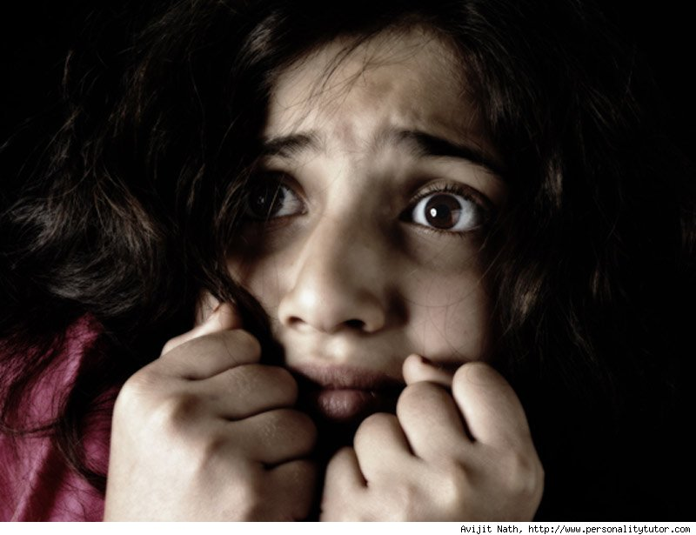
Max Lucado says, “Fear doesn’t want you to make the journey to the mountain. If he can rattle you enough, fear will persuade you to take your eyes off the peaks and settle for a dull existence in the flatlands.”

Slide 4
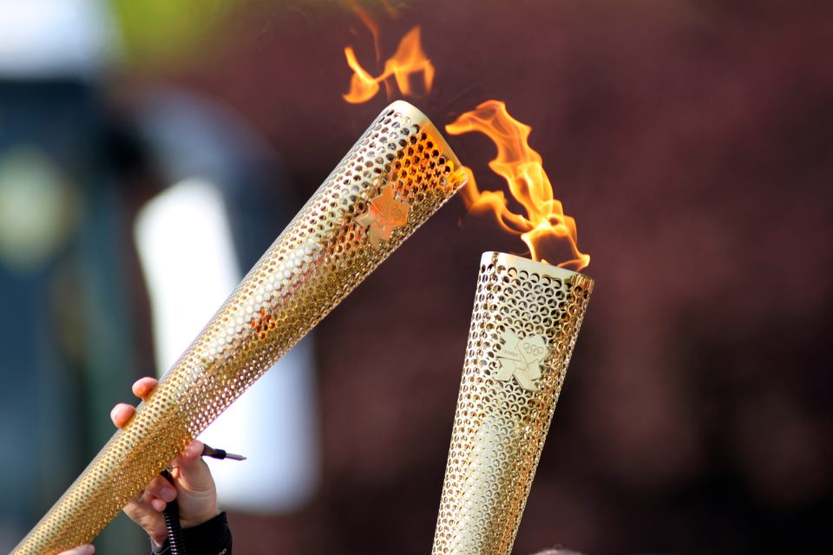
Principles and advice to overcome FEAR
For this reason I remind you to fan into flame the gift of God,

Slide 5
How do we re-kindle our gift?

Slide 6
I. We need to be PROACTIVE, before we gain strength we are to do something.
I remind you to fan into flame the gift of God
a) We do it by self-examination
Are we doing right?

Slide 7
Darius Salter says;
"Today the world observes a church living basically the same lifestyle that it lives. It is not enough for church members not to murder, steal or commit adultery. Most of the world doesn’t do that, at least not blatantly so."

Slide 8
I remind you to fan into flame the gift of God
b) We need determination.
If not…..There is one danger
We become Lukewarm
in our love for the church

Slide 9
I remind you to fan into flame the gift of God
c) We need practical actions
“…stir up the gift of God, which is in you…”

Slide 10
Let’s stir up the gift in us.
Stir it up, =
bring the things on the bottom to the top

Slide 11
2 Timothy 1:7 (KJV)
For God hath not given us the spirit of fear; but of power, and of love, and of a sound mind.
At conversion we were given three strengths

Slide 12
1. Strength of Power
Acts 1:8 (NIV)
“But you will receive power when the Holy Spirit comes on you; and you will be my witnesses in Jerusalem, and in all Judea and Samaria, and to the ends of the earth."
If you are trusting in, drawing from, relying on, believing in the one who has the POWER, He will give you the power you need!

Slide 13
2. Strength of Love
1 John 4:18 (NIV)
There is no fear in love. But perfect love drives out fear, because fear has to do with punishment. The one who fears is not made perfect in love.
Love for God

Slide 14
Romans 8:28 (NIV)
And we know that in all things God works for the good of those who love him, who have been called according to his purpose.
Love for Others

Slide 15
3. Strength of Sound Mind
Romans 12:2 (NIV)
“Do not conform any longer to the pattern of this world, but be transformed by the renewing of your mind. Then you will be able to test and approve what God’s will is--his good, pleasing and perfect will.”
IF I trust in God and accept His way of thinking, I will be assured He will take care of me!

Slide 16
Conquering FEAR
Is not a matter of self determination
It is a matter of dependence on the God whom we can trust and love
It is a matter of belief in His words
His promises, and His gifts to you.

Slide 17
2 Timothy 1:7 (KJV)
For God hath not given us the spirit of fear; but of power, and of love, and of a sound mind.

