Slide 1
Psalm 119
¹⁰⁵ Your word is a lamp for my feet, a light on my path. ¹⁰⁶ I have taken an oath and confirmed it, that I will follow your righteous laws. ¹⁰⁷ I have suffered much; preserve my life, Lord, according to your word. ¹⁰⁸ Accept, Lord, the willing praise of my mouth, and teach me your laws.

Slide 2
Psalm 119
¹⁰⁹ Though I constantly take my life in my hands, I will not forget your law. ¹¹⁰ The wicked have set a snare for me, but I have not strayed from your precepts. ¹¹¹ Your statutes are my heritage forever; they are the joy of my heart. ¹¹² My heart is set on keeping your decrees to the very end.

Slide 3
Let’s Pray…

Slide 4
‘But as for me, it is good to be near God. I have made the Sovereign Lord my refuge; I will tell of all your deeds.’
“A resolution for the New Year”

Slide 5
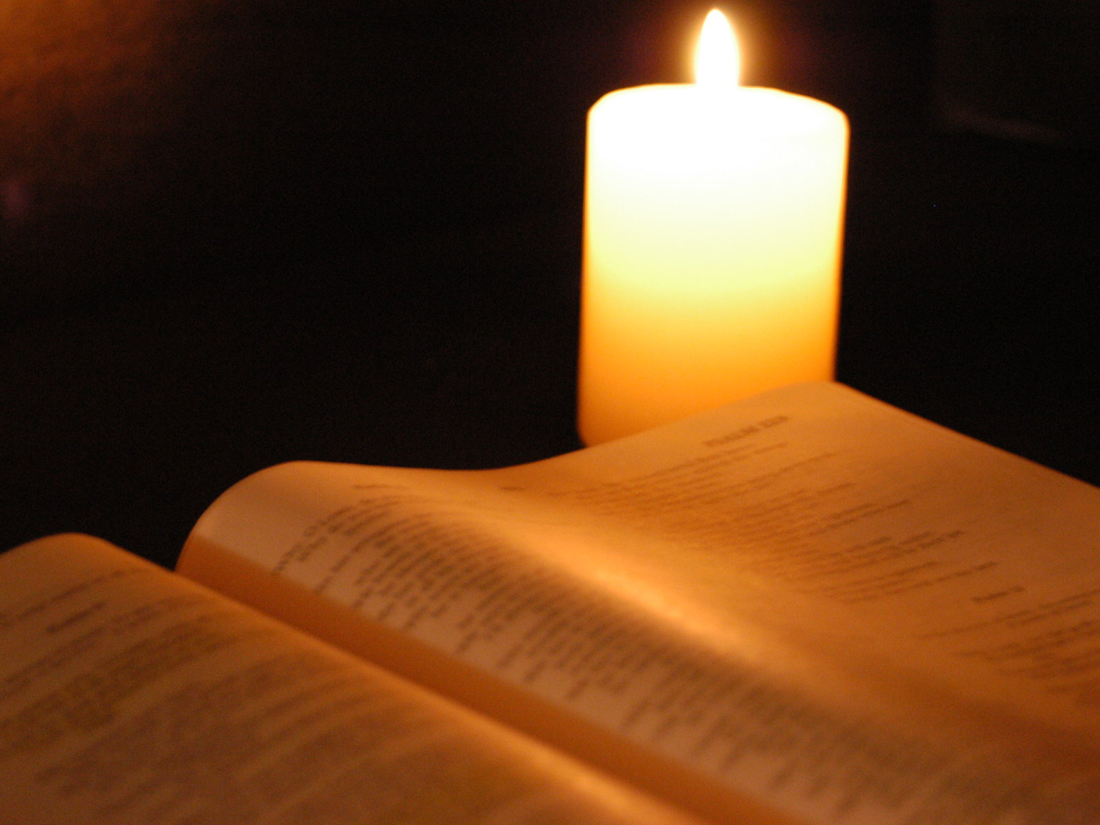
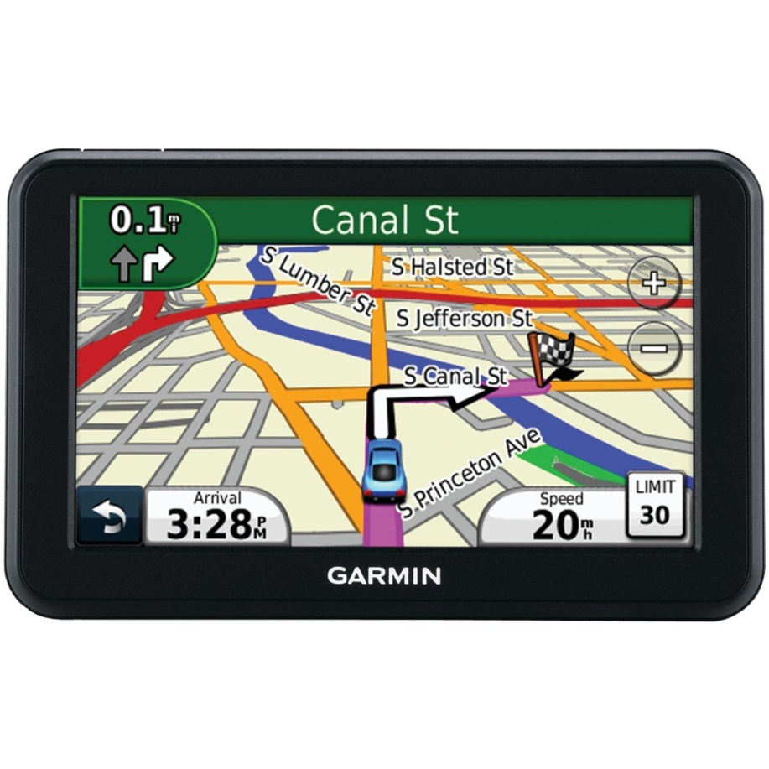
The Bible is an SPS.
A spiritual positioning system!

Slide 6
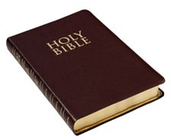
First, he recognised that God’s Word is his light.
Following God’s Word help us to find
our way in life!
Following God’s word shows us how to live life according to God’s plan.

Slide 7
¹⁰⁵ Your word is a lamp for my feet, a light on my path.
God’s word shows us which road to take, it lights our path!!
God’s Word makes God’s way known to me!

Slide 8
Navigation Lights
Under sail without the engine on, a sailboat displays two sidelights and a stern light. Port sidelight is red with green for starboard.

Slide 9
God’s word helps us find our way
“Therefore everyone who hears these words of mine and puts them into practice is like a wise man who built his house on the rock.”
Matthew 7:24 (NIV)

Slide 10
II. The Psalmist vowed to follow the Word of God
¹⁰⁶ I have taken an oath and confirmed it, that I will follow your righteous laws.
The psalmist announces his deliberate purpose to conform his life to God's Word.

Slide 11
III. He was determined to look to God’s Word
¹⁰⁷ I have suffered much; preserve my life, Lord, according to your word.
The Psalmist declares his determination to look only to God's Word for life when he is under affliction.

Slide 12
² Consider it pure joy, my brothers and sisters, whenever you face trials of many kinds, ³ because you know that the testing of your faith produces perseverance. ⁴ Let perseverance finish its work so that you may be mature and complete, not lacking anything.
James 1:2-4 (NIV)

Slide 13
IV. He declared that he would joyfully follow
God’s statutes and decrees.
¹⁰⁸ Accept, Lord, the willing praise of my mouth, and teach me your laws.
The Psalmist announces his delight in worship.
Accept, Lord, the willing praise of my mouth,

Slide 14
“Worship means, in the middle of life as it is experienced, that you find some way to be caught up in God’s character and purpose so that His will becomes central”
Dr Larry Crabb

Slide 15
“…and teach me your laws”.
“…and teach me your rules”.
Hebrews 10:16 (NIV)
“This is the covenant I will make with them after that time, says the Lord. I will put my laws in their hearts, and I will write them on their minds.”

Slide 16
John 15:10-11 (NIV)
¹⁰ If you keep my commands, you will remain in my love, just as I have kept my Father’s commands and remain in his love. ¹¹ I have told you this so that my joy may be in you and that your joy may be complete.

Slide 17
WILLIAM HUNTER.
WILLIAM HUNTER. MARTYR.
Committed to the Flames March 26th MDLV. Christian Reader, learn from his example to value the privilege of an open Bible. And be careful to maintain it

Slide 18
Psalm 119
¹⁰⁵ Your word is a lamp for my feet, a light on my path. ¹⁰⁶ I have taken an oath and confirmed it, that I will follow your righteous laws. ¹⁰⁷ I have suffered much; preserve my life, Lord, according to your word. ¹⁰⁸ Accept, Lord, the willing praise of my mouth, and teach me your laws.

Slide 19
Psalm 119:130 (CEV)
“Understanding your Word brings light to the minds of ordinary people”

